Slide 1
Design Network Implementation
Monitoring
Azure DNS
Security
Azure
Networking
Hybrid Connection
Express Route
Network Services

Slide 2
Design Network Implementation
Design Azure virtual networks
Design solutions that use Azure networking services: design for load balancing using Azure Load Balancer and Azure Traffic Manager; define DNS, DHCP, and IP strategies; determine when to use Azure Application Gateway; determine when to use multi-node application gateways, Traffic Manager and load balancers
Design external connectivity for Azure Virtual Networks
Determine when to use Azure VPN, ExpressRoute and Virtual Network Peering architecture and design; determine when to use User Defined Routes (UDRs); determine when to use VPN gateway site-to-site failover for ExpressRoute
Design security strategies
Determine when to use network virtual appliances; design a perimeter network (DMZ); determine when to use a Web Application Firewall (WAF), Network Security Group (NSG), and virtual network service tunneling
Design connectivity for hybrid applications
Design connectivity to on-premises data from Azure applications using Azure Relay Service, Azure Data Management Gateway for Data Factory, Azure On-Premises Data Gateway, Hybrid Connections, or Azure Web App’s virtual private network (VPN) capability; identify constraints for connectivity with VPN; identify options for joining VMs to domains
https://www.microsoft.com/en-us/learning/exam-70-535.aspx
Notes:
The following topics are not included in this presentations due to time constrains

Slide 3
Networking
1. Design Azure virtual networks - Extend on-premises
Leverage Azure networking services:
Implement load balancing using Azure Load Balancer and Azure Traffic Manager
Define DNS, DHCP, and IP addressing configuration
Define static IP reservations
Apply Network Security Groups (NSGs) and User Defined Routes (UDRs);
Deploy Azure Application Gateway
2. Describe Azure VPN and Express Route architecture and design
Describe Azure point-to-site (P2S) and site-to-site (S2S) VPN
Leverage Azure VPN and ExpressRoute in network architecture

Slide 4
What is Azure Networking?
Networking
Virtual Networks
Network Security Groups
Hybrid:
Extend on-premises
VPN
Point-to-Site
Site-to-Site
ExpressRoute
Networking Services:
Azure Load Balancer
Azure Application Gateway
Azure Traffic Manager
DNS
DHCP
IP Addresses
UDRs
* Bold Red text are key points

Slide 5
Networking: Virtual Networks
Isolated
50/500 Virtual Networks per Region per Subscription
Up to 500K Concurrent TCP connections per VM
Up to 1000 Subnets. Special: GatewaySubnet
300/10,000 NICs per region per sub
Internet Connected by default
Connectivity – to each other via Peering, or to on-prem via VPN, ExpressRoute
Bound to a single region
Use Public IP address Ranges and Private IP Address ranges
Some IP address Ranges are not allowed:
224.0.0.0/4 (Multicast)
255.255.255.255/32 (Broadcast)
127.0.0.0/8 (loopback)
169.254.0.0/16 (link-local)
168.63.129.16/32 (Internal DNS)
https://docs.microsoft.com/en-us/azure/virtual-network/virtual-networks-public-ip-within-vnet

Slide 6
Networking: Virtual Networks
VNet properties
Subnet Properties
Property | Description | Constraints
name | VNet name | String of up to 80 characters. May contain letters, numbers, underscore, periods, or hyphens. Must start with a letter or number. Must end with a letter, number, or underscore. Can contains upper or lower case letters.
location | Azure location (also referred to as region). | Must be one of the valid Azure locations.
addressSpace | Collection of address prefixes that make up the VNet in CIDR notation. | Must be an array of valid CIDR address blocks, including public IP address ranges.
subnets | Collection of subnets that make up the VNet | see the subnet properties table below.
dhcpOptions | Object that contains a single required property named dnsServers.
dnsServers | Array of DNS servers used by the VNet. If no server is specified, Azure internal name resolution is used. | Must be an array of up to 10 DNS servers, by IP address
Property | Description | Constraints
name | Subnet name | String of up to 80 characters. May contain letters, numbers, underscore, periods, or hyphens. Must start with a letter or number. Must end with a letter, number, or underscore. Can contains upper or lower case letters.
location | Azure location (also referred to as region). | Must be one of the valid Azure locations.
addressPrefix | Single address prefix that make up the subnet in CIDR notation | Must be a single CIDR block that is part of one of the VNet's address spaces.
networkSecurityGroup | NSG applied to the subnet
routeTable | Route table applied to the subnet
ipConfigurations | Collection of IP configuration objects used by NICs connected to the subnet

Slide 7

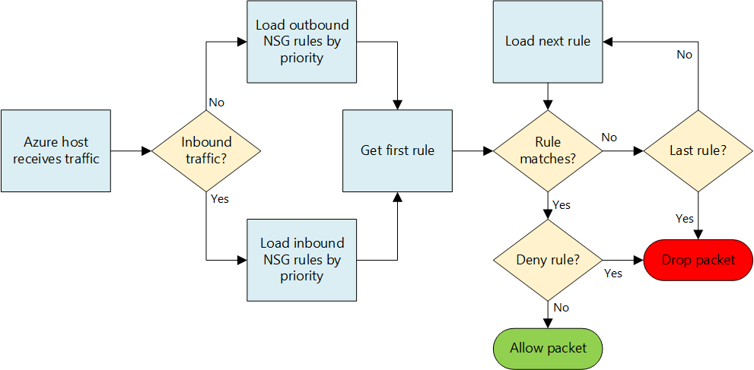
Networking: Network Security Groups
100/400 NSGs per region per sub
Rules per NSG: 200/500
Rules to allow/deny traffic
Rules for inbound/outbound
Can be associated with Subnets and/or directly to NICs attached to VMs.
Rules are based on Protocol, Source Port Range, Destination Port Range, Source Address Prefix, Destination Address Prefix
Default Tags for categories of IP addresses:
VirtualNetwork
AzureLoadbalancer
Internet
Default Rules
Inbound
Allow Vnet, Allow LoadBalancer, Deny All Inbound
Outbound
Allow Vnet, Allow Internet, Deny All Outbound
Service Tags
Application Security Groups
Augmented Rules
https://docs.microsoft.com/en-us/azure/virtual-network/virtual-networks-nsg

Slide 8
Networking: Network Security Groups
Property | Description | Constraints | Considerations
Protocol | Protocol to match for the rule. | TCP, UDP, or * | Using * as a protocol includes ICMP (East-West traffic only), as well as UDP and TCP, and may reduce the number of rules you need. At the same time, using * might be too broad an approach, so it's recommended that you use * only when necessary.
Source port range | Source port range to match for the rule. | Single port number from 1 to 65535, port range (example: 1-65635), or * (for all ports). | Source ports could be ephemeral. Unless your client program is using a specific port, use * in most cases. Try to use port ranges as much as possible to avoid the need for multiple rules. Multiple ports or port ranges cannot be grouped by a comma.
Destination port range | Destination port range to match for the rule. | Single port number from 1 to 65535, port range (example: 1-65535), or * (for all ports). | Try to use port ranges as much as possible to avoid the need for multiple rules. Multiple ports or port ranges cannot be grouped by a comma.
Source address prefix | Source address prefix or tag to match for the rule. | Single IP address (example: 10.10.10.10), IP subnet (example: 192.168.1.0/24), default tag, or * (for all addresses). | Consider using ranges, default tags, and * to reduce the number of rules.
Destination address prefix | Destination address prefix or tag to match for the rule. | Single IP address (example: 10.10.10.10), IP subnet (example: 192.168.1.0/24), default tag, or * (for all addresses). | Consider using ranges, default tags, and * to reduce the number of rules.
Direction | Direction of traffic to match for the rule. | Inbound or outbound. | Inbound and outbound rules are processed separately, based on direction.
Priority | Rules are checked in the order of priority. Once a rule applies, no more rules are tested for matching. | Number between 100 and 4096. | Consider creating rules jumping priorities by 100 for each rule to leave space for new rules you might create in the future.
Access | Type of access to apply if the rule matches. | Allow or deny. | Keep in mind that if an allow rule is not found for a packet, the packet is dropped.

Slide 9
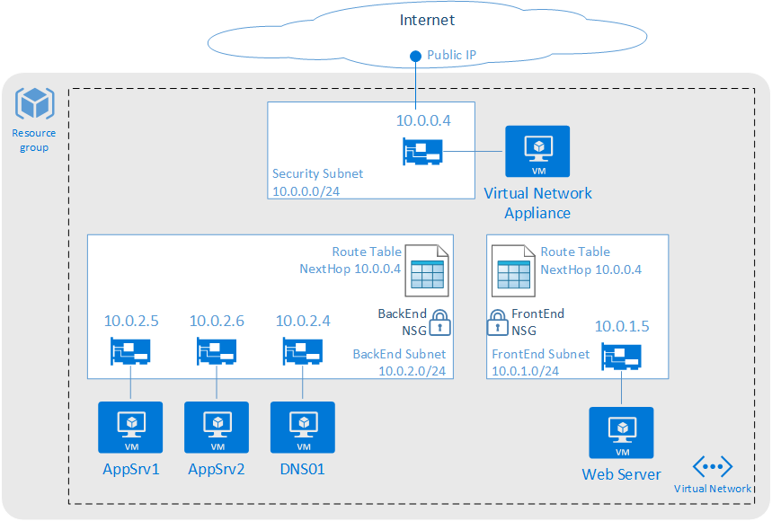
Route Tables
User defined routes
Routes to overwrite Azure system routes
Associated to subnets
Specify next hop
Virtual Appliance
Virtual Network Gateway
None
Virtual Network
Internet
Configure routes in route table
Route Name
Address Prefix (Destination Address)
Next hop type
Next hop address (Virtual Appliance)
100/200 Route Tables per subscription
100/400 routes per Route Table
Notes:
User Defined Routes
Ability to control traffic flow
Imagine we have two subnets within one Vnet
By default all machines in a Vnet can communicate with each other so there is full routed network between them
You don’t want your front end subnet communicate directly with your back end subnet
You want to have your own firewall appliance or an IDS system in between the traffic flow to accomplish that solution we can use User Defined Routes to force the traffic coming to backend subnet that is coming from front end subnet through the firewall instance
You can configure UDR’s for both internal traffic and the traffic leaving your Azure network

Slide 10
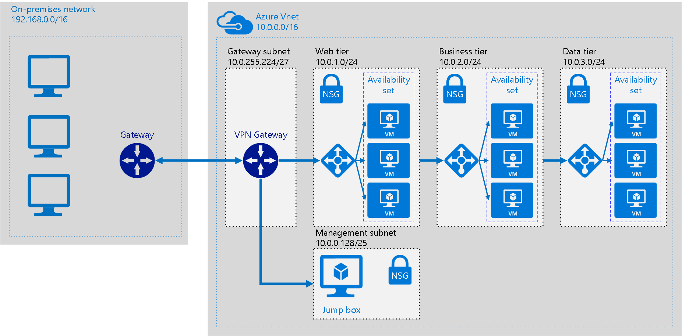
Hybrid: Extend On Premises

Slide 11
Hybrid: Extend On Premises
At a high level, most hybrid configurations require 5 resources:
VNET
Gateway Subnet
Azure VNET Gateway
“Local” Gateway
Connection
Planning a Hybrid Networking Architecture:
https://docs.microsoft.com/en-us/azure/vpn-gateway/vpn-gateway-plan-design

Slide 12
Hybrid: VPN
VPN
Types
Policy-Based (Static Routing)
Route-Based (Dynamic Routing)
Learn more: https://docs.microsoft.com/en-us/azure/architecture/reference-architectures/hybrid-networking/
SKUs
Basic (99.9% SLA)
Standard (99.95% SLA)
High Performance (99.95% SLA)
 | VPN Gateway throughput (1) | VPN Gateway max IPsec tunnels (2) | ExpressRoute Gateway throughput | VPN Gateway and ExpressRoute coexist
Basic SKU (3)(5)(6) | 100 Mbps | 10 | 500 Mbps (6) | No
Standard SKU (4)(5) | 100 Mbps | 10 | 1000 Mbps | Yes
High Performance SKU (4) | 200 Mbps | 30 | 2000 Mbps | Yes

Slide 13
Hybrid: VPN
 | PolicyBased Basic VPN Gateway | RouteBased Basic VPN Gateway | RouteBased Standard VPN Gateway | RouteBased High Performance VPN Gateway
Site-to-Site connectivity (S2S) | PolicyBased VPN configuration | RouteBased VPN configuration | RouteBased VPN configuration | RouteBased VPN configuration
Point-to-Site connectivity (P2S) | Not supported | Supported (Can coexist with S2S) | Supported (Can coexist with S2S) | Supported (Can coexist with S2S)
Authentication method | Pre-shared key | Pre-shared key for S2S connectivity, Certificates for P2S connectivity | Pre-shared key for S2S connectivity, Certificates for P2S connectivity | Pre-shared key for S2S connectivity, Certificates for P2S connectivity
Maximum number of S2S connections | 1 | 10 | 10 | 30
Maximum number of P2S connections | Not supported | 128 | 128 | 128
Active routing support (BGP) | Not supported | Not supported | Supported | Supported
https://docs.microsoft.com/en-us/azure/vpn-gateway/vpn-gateway-plan-design

Slide 14
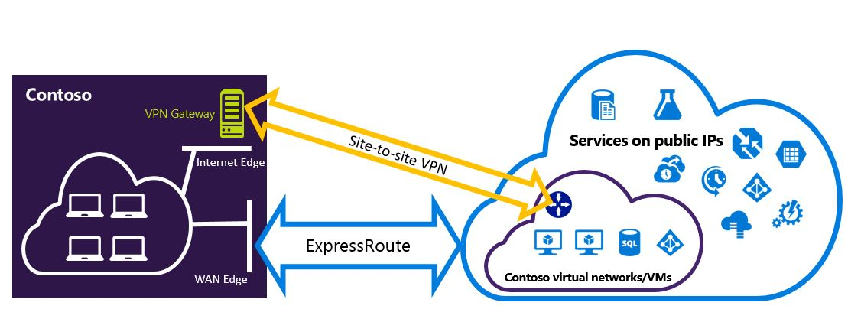
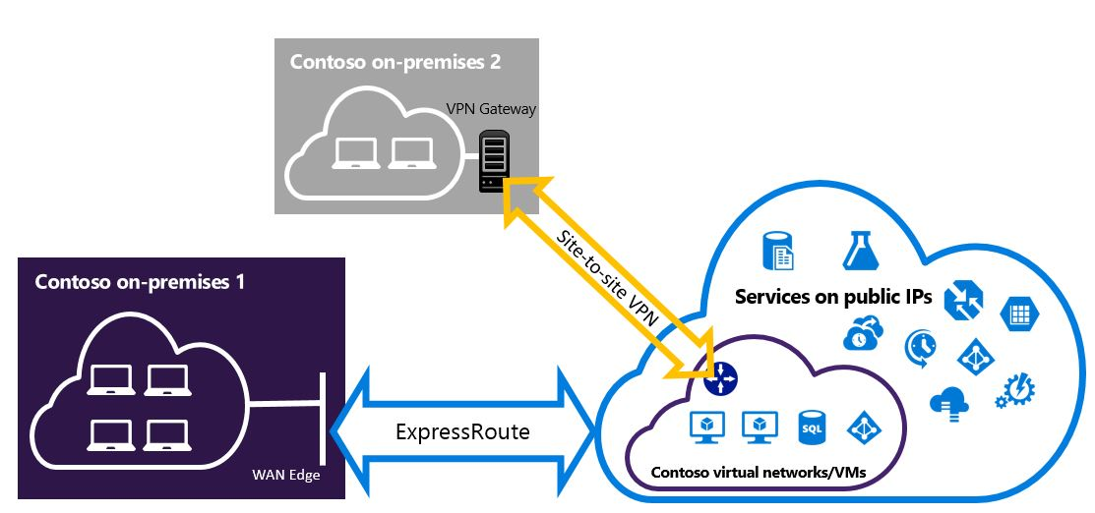
Hybrid: VPN
On-Premises VPN appliances
https://docs.microsoft.com/en-us/azure/vpn-gateway/vpn-gateway-about-vpn-device
Point-to-Site, Site-to-Site, ExpressRoute
https://docs.microsoft.com/en-us/azure/vpn-gateway/vpn-gateway-about-vpn-devices
ExpressRoute & Site-to-Site Co-Exist
https://docs.microsoft.com/en-us/azure/expressroute/expressroute-howto-coexist-resource-manager
Point-to-Site supports Mac clients

Slide 15
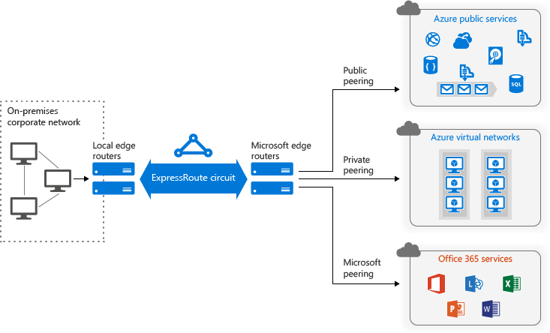
Hybrid: Express Route
Express Route
Merged Public & Microsoft Peering

Slide 16
Express Route Standard vs Premium Add-on
Number of Routes | Express Route | Premium add-on
Private Peering | 4,000 | 10,000
Public Peering | 200 | 200
Microsoft Peering | 200 | 200
Circuit Size | Number of VNet links for standard | Number of VNet Links with Premium add-on
50 Mbps | 10 | 20
100 Mbps | 10 | 25
200 Mbps | 10 | 25
500 Mbps | 10 | 40
1 Gbps | 10 | 50
2 Gbps | 10 | 60
5 Gbps | 10 | 75
10 Gbps | 10 | 100
Global connectivity for services - An ExpressRoute circuit created in any region
(excluding Azure China, Azure Germany, and Azure Government cloud)
will have access to resources across any other region in the world.
Notes:
Increased no of Vnet links
Increased route limits
Global connectivity with premium add-on–
Link Vnet in West Europe to Express Route provisioned in West US

Slide 17
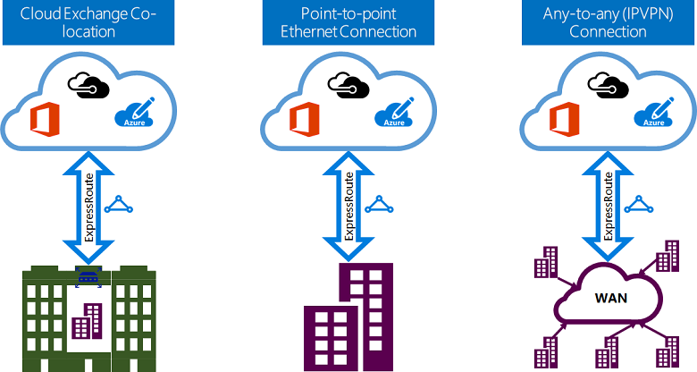
Hybrid: ExpressRoute
ExpressRoute
Layer 2 / Layer 3
https://docs.microsoft.com/en-us/azure/expressroute/expressroute-connectivity-models

Slide 18
Hybrid: ExpressRoute (99.95% SLA)
10 ER circuits per region per sub (ARM)
Min/Max Circuit Size = 50 Mbps / 10 Gbps
10 VNet Links per circuit
2 Plans (Metered, Unlimited), Multiple Port Speeds
https://azure.microsoft.com/en-us/pricing/details/expressroute/
ExpressRoute Premium Add-on
Increased route limits for public and private peering from 4,000 routes to 10,000 routes.
Global connectivity for services. An ExpressRoute circuit created in any region (excluding Azure China, Azure Germany, and Azure Government cloud) will have access to resources across any other region in the world.
Without Premium Add-On, ER circuit limited to geo-political area
Increased number of VNet links per ExpressRoute circuit from 10 to a larger limit (depending on the bandwidth of the circuit). 20 - 100
ExpressRoute videos
https://channel9.msdn.com/Shows/Azure-Friday/Azure-Hybrid-Networking-101
https://channel9.msdn.com/Shows/Azure-Friday/Azure-Hybrid-Networking-201

Slide 19
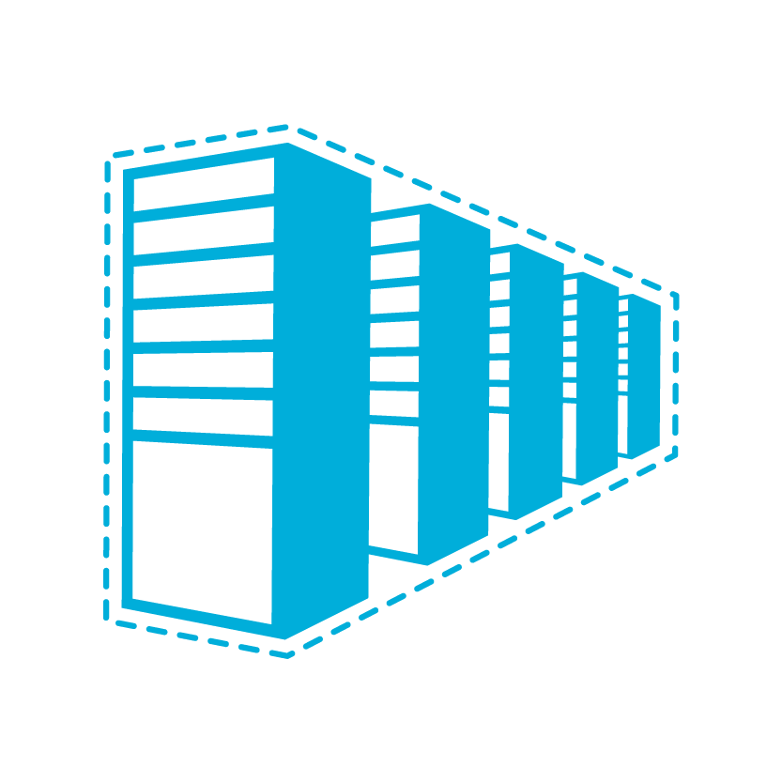
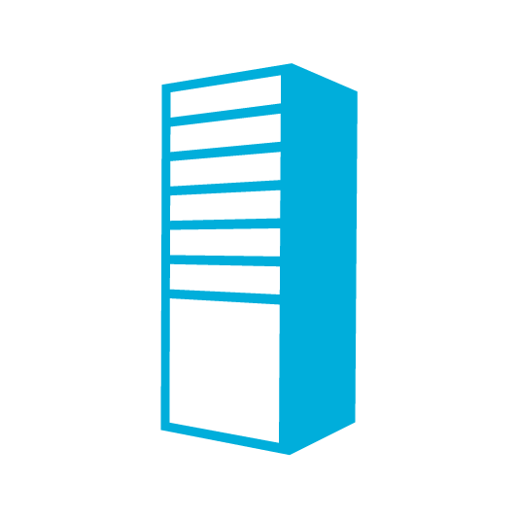

Hybrid Network Design Considerations
Cloud
Customer
Segment and workloads
Consumers
Access over public IP
DNS resolution
Connect from anywhere
Internet Connectivity
Developers
POC Efforts
Small scale deployments
Connect from anywhere
Secure point-to-site connectivity
SMB, Enterprises
Connect to Azure compute
Secure site-to-site
VPN connectivity
SMB & Enterprises
Mission critical workloads
Backup/DR, media, HPC
Connect to Microsoft services
ExpressRoute private connectivity

Slide 20
You want to let your mobile workers connect to a Network in Azure so they can access an internal only system. What VPN solution should you deploy?
Vnet to Vnet
Point to Site
Site to Site
ExpressRoute

Slide 21
You want to let your mobile workers connect to a Network in Azure so they can access an internal only system. What VPN solution should you deploy?
Vnet to Vnet
Point to Site
Site to Site
ExpressRoute

Slide 22
Network Services

Slide 23
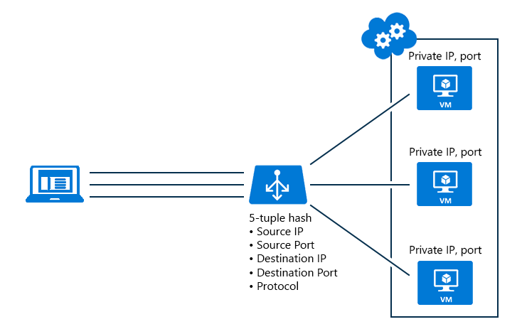
Network Services: Load Balancer
Hash-based distribution
5 tuple and 2 or 3 tuple
Port forwarding (e.g. Port 80 to Port 81)
Automatic Reconfiguration
Service Monitoring
Guest probe
HTTP custom probe
TCP custom probe
NAT Capability
Source NAT (share same VIP)
100 per subscription
150 rules per Load Balancer
https://docs.microsoft.com/en-us/azure/load-balancer/load-balancer-overview
Supports 1000 VMs
Availability Zones
HA Ports

Slide 24
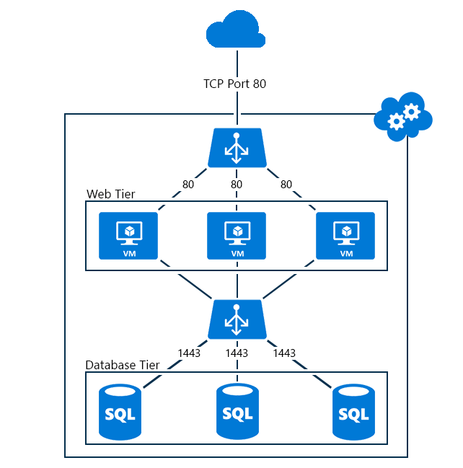
Network Services: Load Balancer
Public / Internet Facing Load Balancer
Internal Load Balancer
Outbound traffic & Source NAT
Scenario | Method | Note
Standalone VM (no load balancer, no Instance Level Public IP address) | Default SNAT | Azure associates a public IP address for SNAT
Load-balanced VM (no Instance Level Public IP address on VM) | SNAT using the load balancer | Azure uses a public IP address of the Load Balancer for SNAT
VM with Instance Level Public IP address (with or without load balancer) | SNAT is not used | Azure uses the public IP assigned to the VM
https://docs.microsoft.com/en-us/azure/load-balancer/load-balancer-outbound-connections

Slide 25
Standard Load Balancer
Preview
VM need not be deployed in a Availability Set
Cross-Zone load balancing
Limited to region and not supported in peered networks
NIC or Subnet level NSG is mandatory
Migration from basic to standard SKU
High availability using HA ports
100/1000 Load balancers per subscription
1250/1500 rules per Basic Load Balancer
1000 Backend pools with VMs on single VNet
10 Frontend IP’s
Need to signup for preview
East US 2, Central US, North Europe, West Central US, West Europe, and Southeast Asia
Notes:
Customer Story on adding VM that is not in Availability set
No Availability sets needed
Features –
Low Latency
High throughput
Cross-Zone load balancing
Limited to region
not supported in peered networks
NSG is required on the NIC associated with Standard load balancer
Provides Diagnostic Insights using Azure Monitor

Slide 26
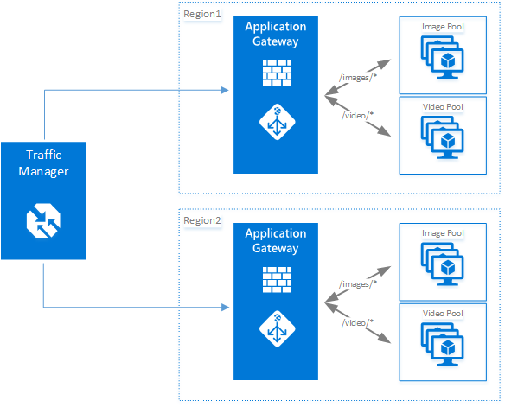
Network Services: Application Gateway
Layer 7 Load balancer, 99.95% SLA
HTTP(S) Load balancing
Cookie based session affinity
Web Application Firewall built-in
SSL Offload
End-to-End SSL
URL based content routing
Multi-site routing
Websockets
3 sizes: Small, Medium, Large
Up to 10 instances per gateway.
50 App Gateways pe Subscription
20 Backend Pools per App Gateway
https://docs.microsoft.com/en-us/azure/application-gateway/application-gateway-introduction

Slide 27
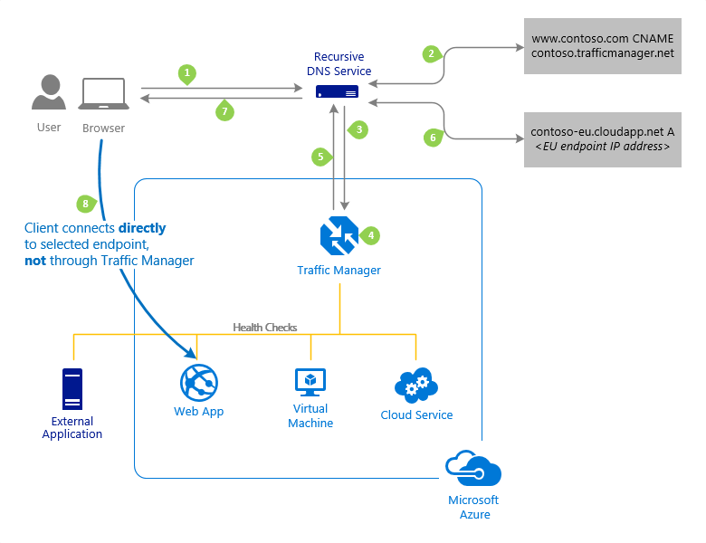
Traffic Manager
control the distribution of user traffic for service endpoints
Uses DNS to route traffic based on traffic routing method –
Priority
Weighted
Performance
Geographic
Endpoint monitoring
Benefits –
Improve availability of critical applications
Improve responsiveness for high performance applications
Perform service maintenance without downtime
100 profiles per subscription and 200 Endpoints per profile
Notes:
Service Endpoints - Azure VMs, Web Apps, and cloud services.
#You can also use Traffic Manager with external, non-Azure endpoints.
Working – uses Domain Name System (DNS) to direct client requests to the most appropriate endpoint based on a traffic-routing method and the health of the endpoints.
Priority - For backup and DR
Weighted - distribute traffic across a set of endpoints, either evenly or according to weights, which you define
Performance - "closest" endpoint in terms of the lowest network latency.
Geographic - geographic location their DNS query originates from

Slide 28
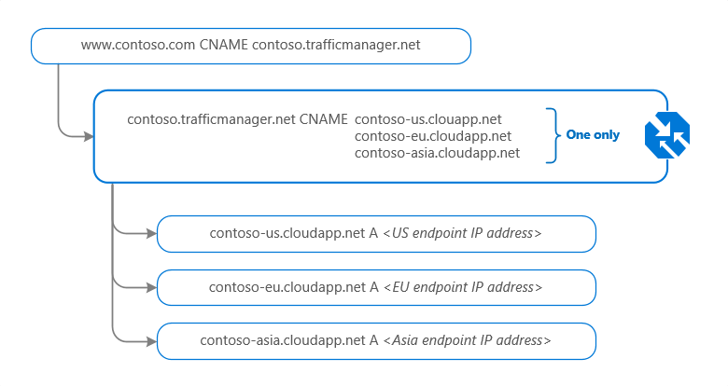
Network Services: Traffic Manager
Endpoint Types
Azure
External
Nested
Web Apps
https://docs.microsoft.com/en-us/azure/traffic-manager/traffic-manager-endpoint-types

Slide 29
Network Services
Load Balancer vs Application Gateway vs Traffic Manager
Service | Azure Load Balancer | Application Gateway | Traffic Manager
Technology | Transport level (Layer 4) | Application level (Layer 7) | DNS level
Application protocols supported | Any | HTTP, HTTPS, and WebSockets | Any (An HTTP endpoint is required for endpoint monitoring)
Endpoints | Azure VMs and Cloud Services role instances | Any Azure internal IP address, public internet IP address, Azure VM, or Azure Cloud Service | Azure VMs, Cloud Services, Azure Web Apps, and external endpoints
Vnet support | Can be used for both Internet facing and internal (Vnet) applications | Can be used for both Internet facing and internal (Vnet) applications | Only supports Internet-facing applications
Endpoint Monitoring | Supported via probes | Supported via probes | Supported via HTTP/HTTPS GET

Slide 30
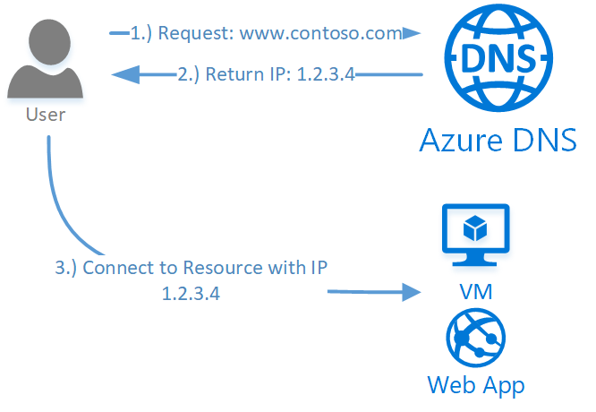
Network Services: Azure DNS
Azure Service for managing Public DNS (99.99% SLA)
Integrates with Azure Management Services
Controlled with Role Based Access Control
100 DNS Zones per subscription
5000 Record sets per zone
20 Records per record set
https://docs.microsoft.com/en-us/azure/dns/dns-overview

Slide 31
Networking Services: Private DNS
Scenario | Solution | Suffix
Name resolution between role instances or VMs located in the same cloud service or virtual network | Azure-provided name resolution | hostname or FQDN
Name resolution between role instances or VMs located in different virtual networks | Customer-managed DNS servers forwarding queries between vnets for resolution by Azure (DNS proxy). see Name resolution using your own DNS server | FQDN only
Resolution of on-premises computer and service names from role instances or VMs in Azure | Customer-managed DNS servers (e.g. on-premises domain controller, local read-only domain controller or a DNS secondary synced using zone transfers). See Name resolution using your own DNS server | FQDN only
Resolution of Azure hostnames from on-premises computers | Forward queries to a customer-managed DNS proxy server in the corresponding vnet, the proxy server forwards queries to Azure for resolution. See Name resolution using your own DNS server | FQDN only
Reverse DNS for internal IPs | Name resolution using your own DNS server | n/a
Name resolution between VMs or role instances located in different cloud services, not in a virtual network | Not applicable. Connectivity between VMs and role instances in different cloud services is not supported outside a virtual network. | n/a
Use Azure Provided, OR
Bring Your Own?
Azure DNS Private Zones for cross VNET name resolution
https://docs.microsoft.com/en-us/azure/virtual-network/virtual-networks-name-resolution-for-vms-and-role-instances

Slide 32
Networking Services: Private DNS
Azure Provided
No configuration, Highly Available
Intra VNET name resolution doesn’t require FQDN
DNS suffix cannot be modified
WINS and NetBIOS not supported
DNS queries are throttled
Your Own DNS Server
Forwarded DNS Requests are sent to reserved IP 168.63.129.16
Specify DNS Server per Virtual Network or NIC
20/100 DNS Servers per Virtual Network

Slide 33
Networking Services: DHCP
Private IP address allocations:
Dynamic (default)
Static – survives stop/start
Use Static for
VMs that act as domain controllers or DNS servers.
Resources that require firewall rules using IP addresses.
Resources accessed by other apps/resources through an IP address.
Can be associated with
VM, Load Balancer, App Gateway
https://docs.microsoft.com/en-us/azure/virtual-network/virtual-network-ip-addresses-overview-arm

Slide 34
Networking Services: IP Addresses
Public and Private
4096 Private IP addresses per vnet
60 Dynamic Public IPs
20 Static Public IPs
Public IP addresses can be dynamic or static.
Dynamic IP address is not allocated until associated resource is created/started.
Dynamic IP Released when stop/delete resource.
Static IP address allocated immediately. Released only when it is deleted.
Use with
Virtual machines (VM)
Internet-facing load balancers
VPN gateways
Application gateway
Azure Datacenter IP Ranges: https://www.microsoft.com/en-us/download/details.aspx?id=41653
https://docs.microsoft.com/en-us/azure/virtual-network/virtual-network-ip-addresses-overview-arm#public-ip-addresses

Slide 35
Networking Services: User Defined Routes
System Routes allow VMs to communicate with each other inside a VNET
Out of the box, 3 rules:
Local Vnet Rule: Intra and Inter Subnet communication
Internet Rule: VMs to Internet
On-Prem Rule: VNET to on-prem via VPN
VNET to VNET via a Gateway or Peering also supported
User Defined Routes (UDR) to control the routing of packets
Force Tunneling to the Internet via on-prem network
Use Virtual Appliances
Route selection order: User Defined Route, BGP Route (with ER), System Route
IP forwarding allows a VM like a Virtual Appliance to receive traffic addressed to other destinations
100/200 User defined Routes per region per subscription

Slide 36
UDR

Slide 37
I am updating an app to a new release. I want to minimize downtime as much as possible and slowly introduce the release into production. Which Traffic Manager routing method should I use?
Weighted
Priority
Performance
Geographic

Slide 38
I am updating an app to a new release. I want to minimize downtime as much as possible and slowly introduce the release into production. Which Traffic Manager routing method should I use?
Weighted
Priority
Performance
Geographic

Slide 39
You've got an Azure Vnet in Europe and one in North America. What is the most cost effective way to connect these vnets so they can communicate securely?
Vnet Peering
Vnet-to-Vnet Connection
ExpressRoute
Connect through on-prem with VPNs

Slide 40
You've got an Azure Vnet in Europe and one in North America. What is the most cost effective way to connect these vnets so they can communicate securely?
Vnet Peering
Vnet-to-Vnet Connection
ExpressRoute
Connect through on-prem with VPNs

Slide 41
I have 25 IIS websites that I want to host in Azure. Each has a separate domain. Some require https and some require cookie based session affinity. At a minimum, what will I need?
2 Public IP Addresses
25 Application Gateways
25 Application Gateway Instances
2 Application Gateways
25 Public IP Addresses

Slide 42
I have 25 IIS websites that I want to host in Azure. Each has a separate domain. Some require https and some require cookie based session affinity. At a minimum, what will I need?
2 Public IP Addresses
25 Application Gateways
25 Application Gateway Instances
2 Application Gateways
25 Public IP Addresses

Slide 43
Clients outside of Azure access my VM by IP address. I’ve maxed out my static Public IP addresses for the subscription and I occasionally need to turn the VM off. What is the most cost effective alternative?
Private Static IP address and a Dynamic Public IP address
Application Gateway with Dynamic Public IP address
VPN with a Dynamic Public IP address
Load Balancer with Dynamic Public IP address
Never turn off the VM

Slide 44
Clients outside of Azure access my VM by IP address. I’ve maxed out my static Public IP addresses for the subscription and I occasionally need to turn the VM off. What is the most cost effective alternative?
Private Static IP address and a Dynamic Public IP address
Application Gateway with Dynamic Public IP address
VPN with a Dynamic Public IP address
Load Balancer with Dynamic Public IP address
Never turn off the VM

Slide 45
70-535 Azure Skill Up
Free Test Prep Voucher:
skillupmsft@microsoft.com
50% Azure Exam Voucher
Delivered by email after event
Post Event Eval:
https://tinyurl.com/535NC64

